Slide 1

Fire truck
Mureșan Salomeea
Stânea Georgiana Grațiela
Mera Mihai Mircea

Slide 2
Table of contents
Components
Arduino code
Bluetooth control
Further developments
Project demonstration

Slide 3
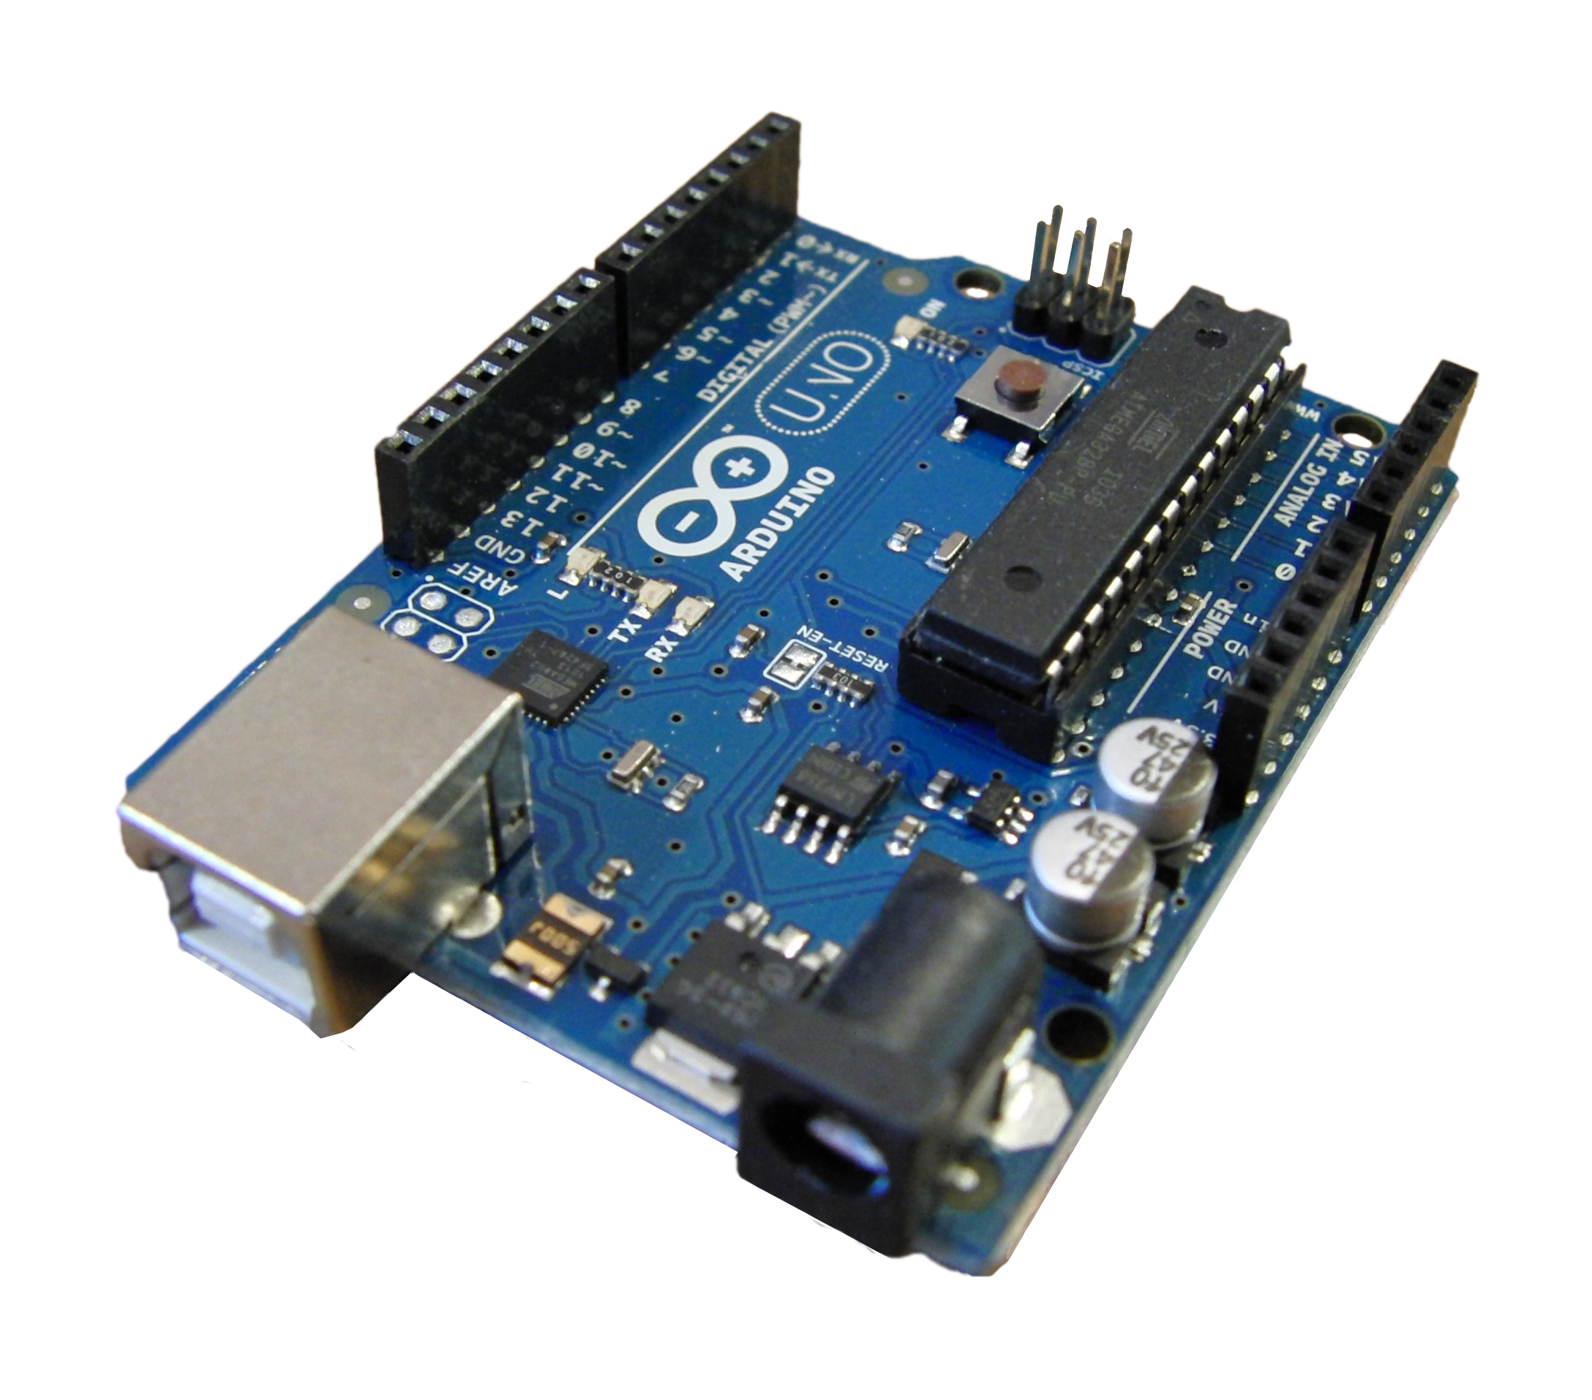
Components used
Arduino Uno
The Arduino Uno is a microcontroller board equipped with sets of digital and analog input/output (I/O) pins that may be interfaced to various expansion boards and other circuits. The board has 14 digital I/O pins, 6 analog I/O pins, and is programmable with the Arduino IDE (Integrated Development Environment), via a type B USB cable. It can be powered by the USB cable or by an external 9-volt battery, though it accepts voltages between 7 and 20 volts.

Slide 4
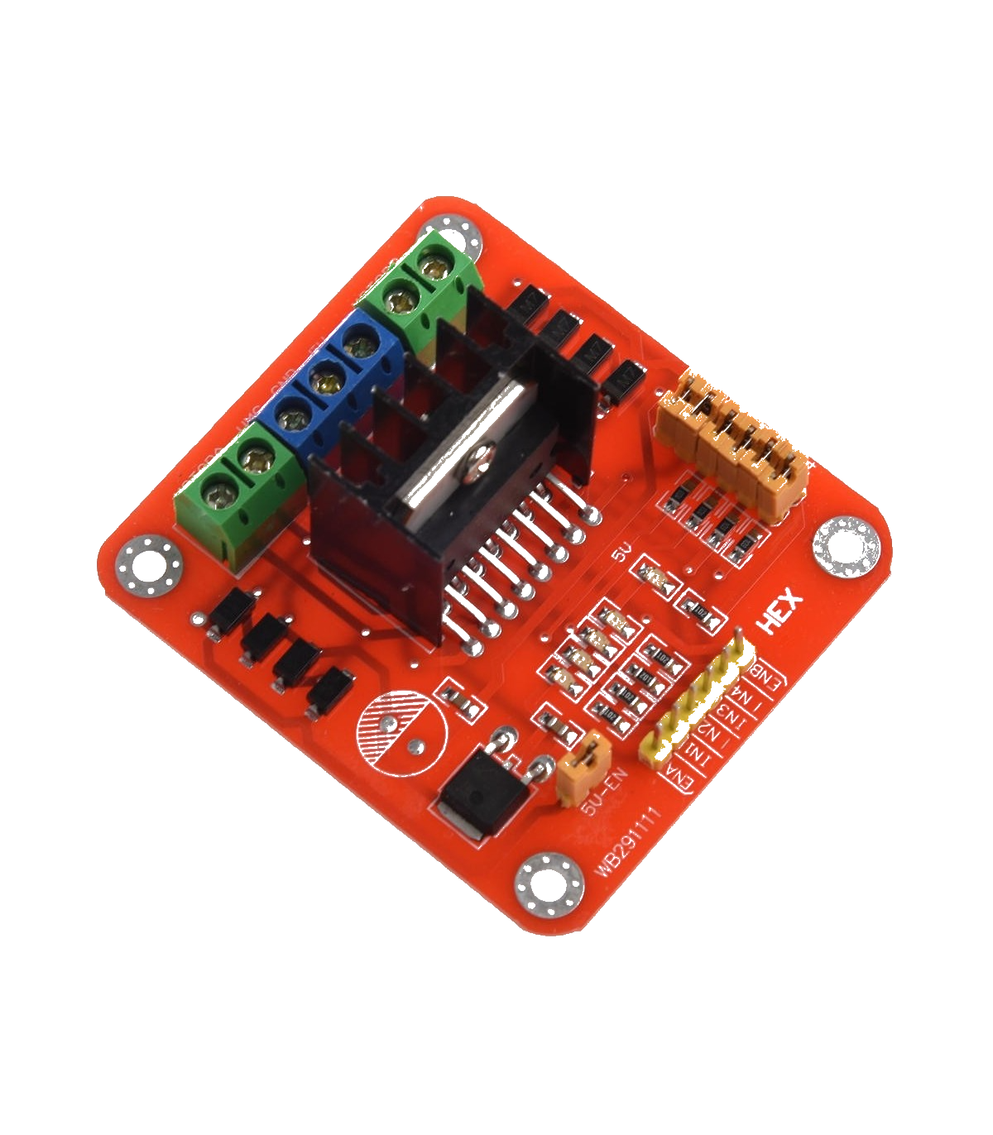
L298N Dual Motor Driver Module
The L298N Motor Driver is a controller that uses an H-Bridge to easily control the direction and speed of up to 2 DC motors. There is also an onboard 5V regulator - so if you're using between 7 and 12V DC to driver the motors, you can connect the jumper to allow this voltage regulator to supply 5V to your L298's logic circuit.
Features:
- Dual H bridge drive
Logical voltage: 5V
Motor supply voltage: 5V-35VDC
Drive current: 2A per DC motor

Slide 5
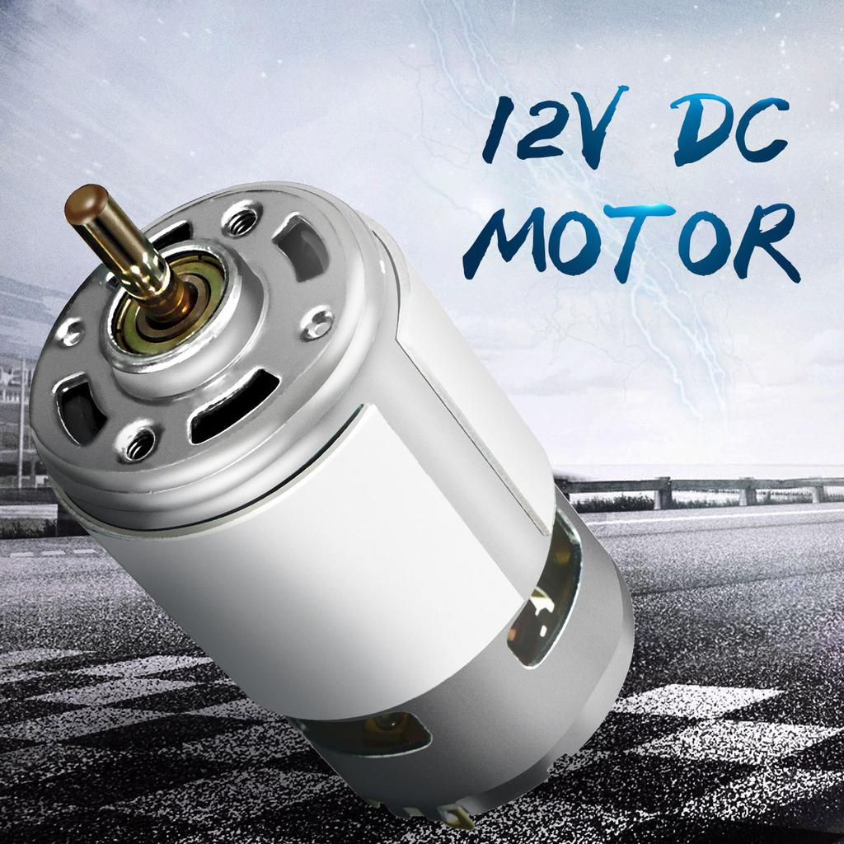
12V DC Motors (4)
DC motors normally have just two leads, one positive and one negative. If you connect these two leads directly to a battery, the motor will rotate. If you switch the leads, the motor will rotate in the opposite direction. To control the direction of the spin of DC motors we used the Dual Motor Driver Module (presented before).

Slide 6
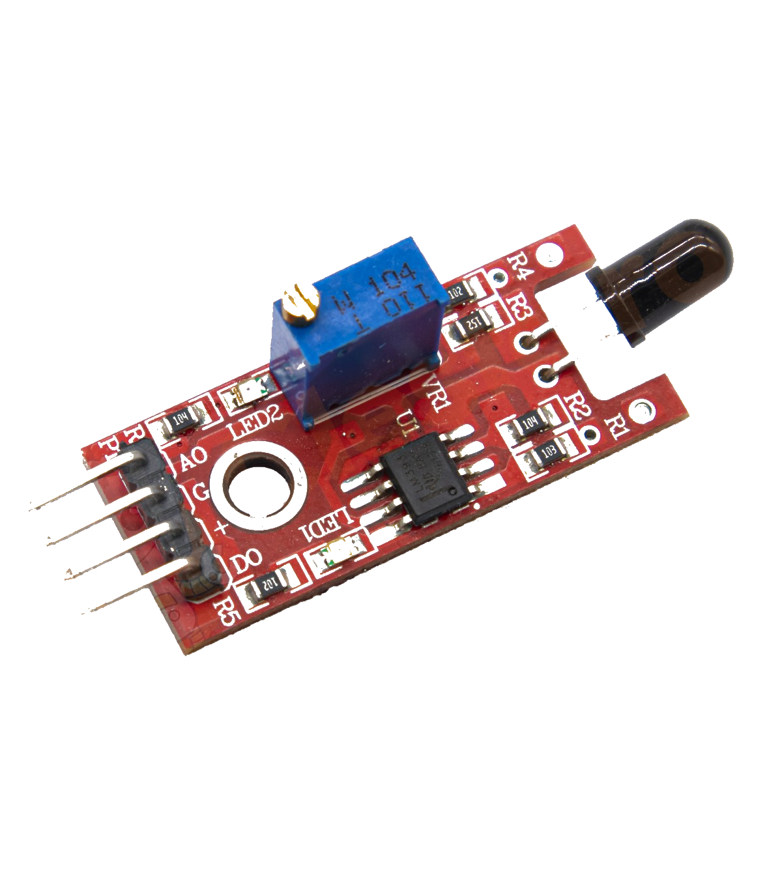
Flame Sensor Module
These types of sensors are used for short range fire detection (mostly accurate up to about 1m).
The flame sensor is very sensitive to IR wavelength at 760 nm ~ 1100 nm light. There are two types of outputs:
Analog output (A0): Real-time output voltage signal on the
thermal resistance.
Digital output (D0): indicates the presence of a signal. Sensing is
conditioned by a comparator.
Pins:
VCC...... Positive voltage input: 5v for analog 3.3v for Digital.
A0.......... Analog output
D0......... Digital output
GND..... Ground

Slide 7
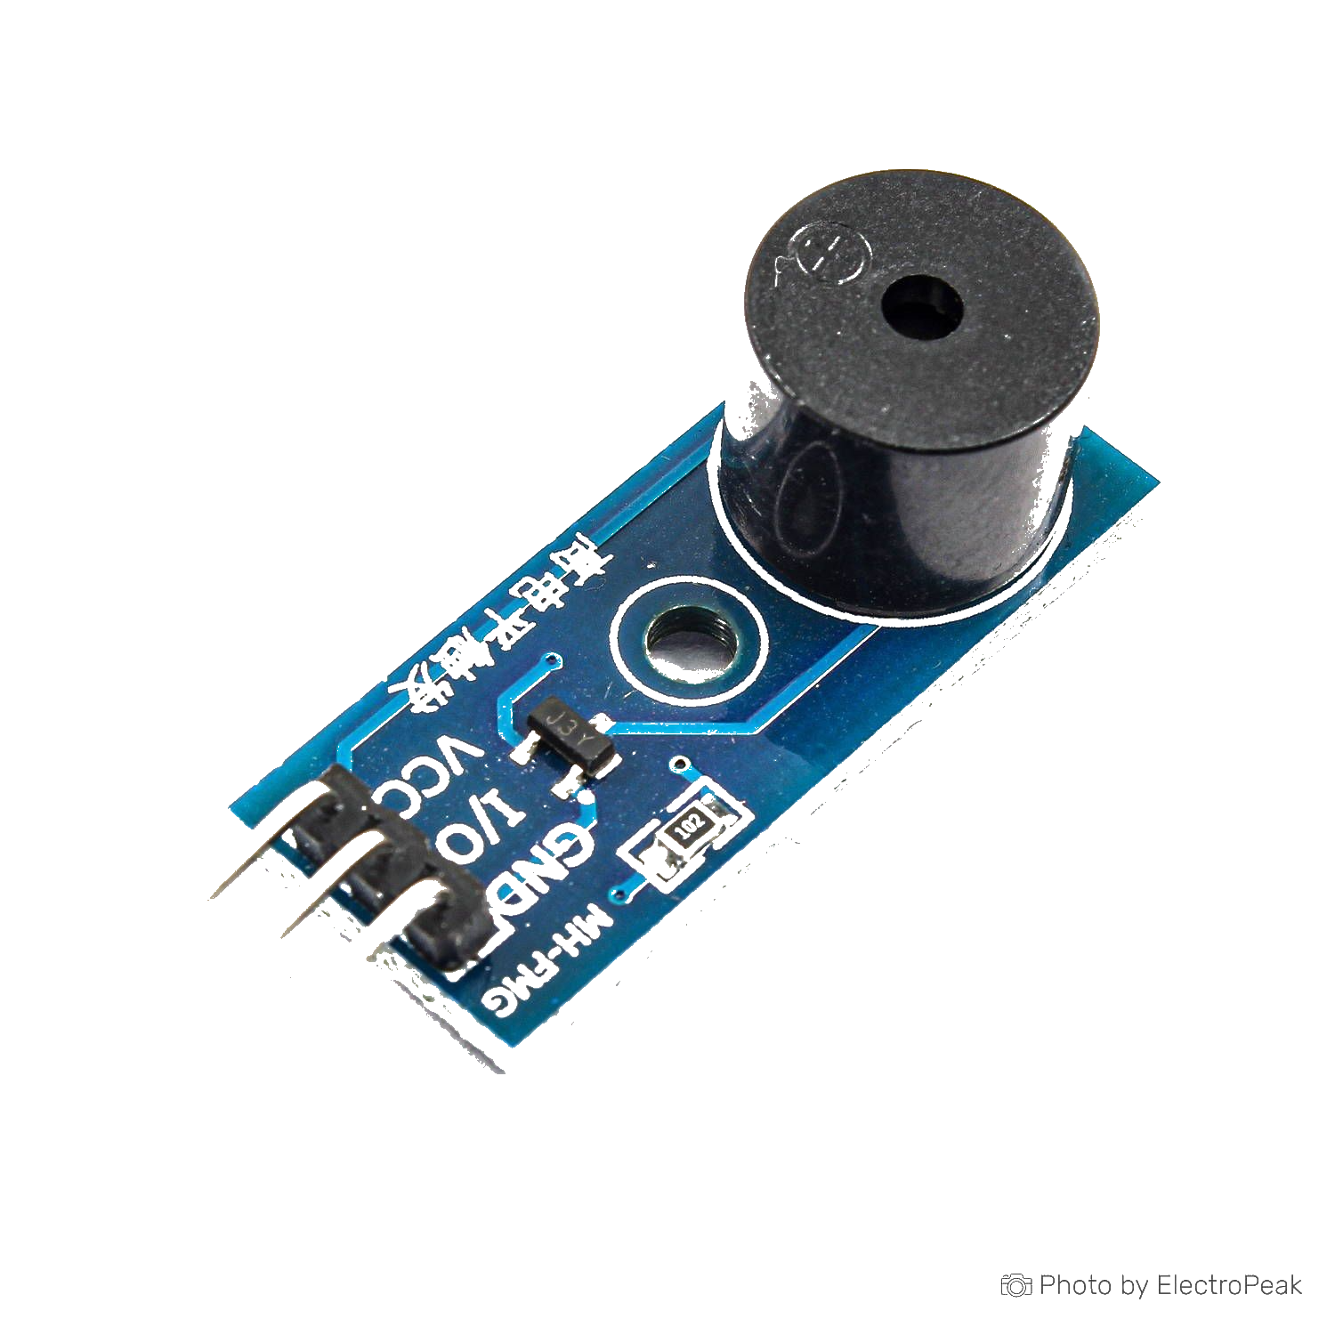
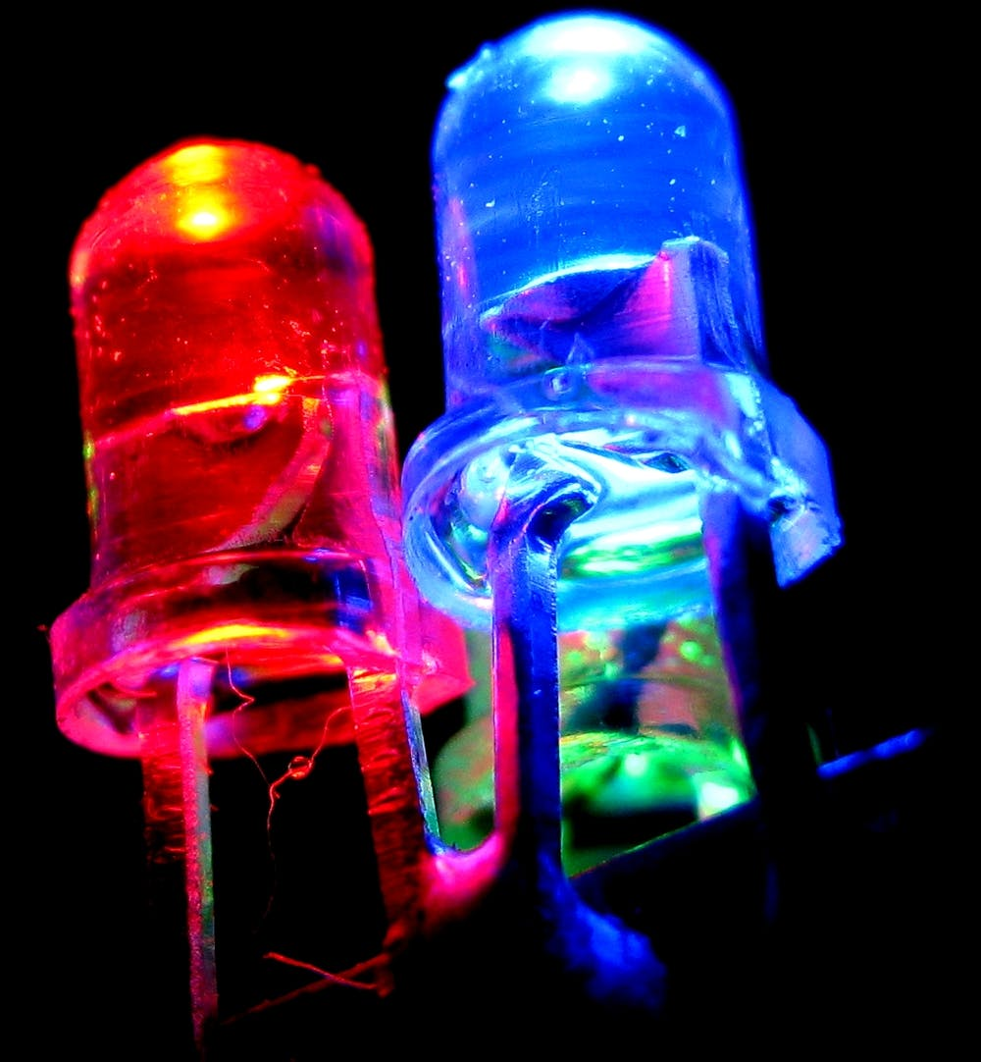
Active Buzzer Module
This is a small buzzer module that operates around the audible 2 kHz frequency range. It is an active buzzer, which means that it produces the sound by itself, without any external frequency generator. This is activated when the fire sensor detects a higher temperature.
Red and blue LEDs
They also turn on at the signal of the fire sensor.

Slide 8
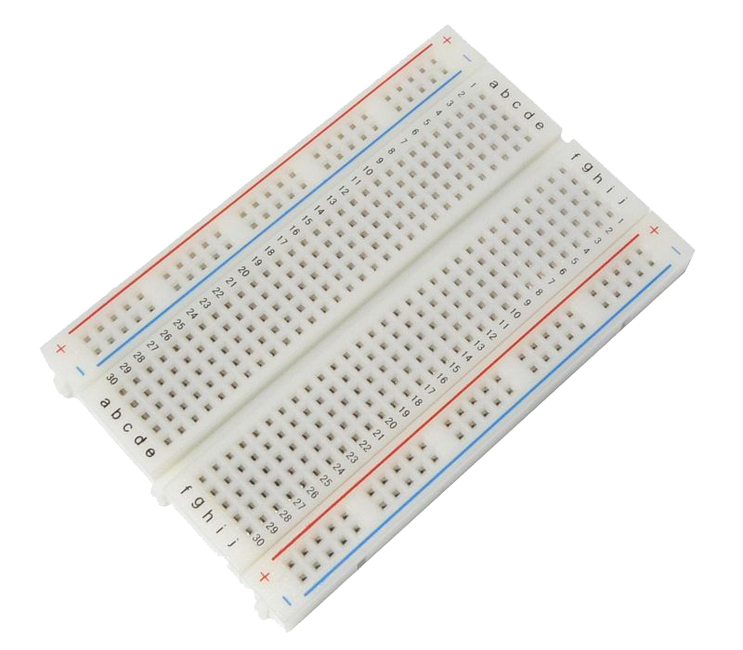
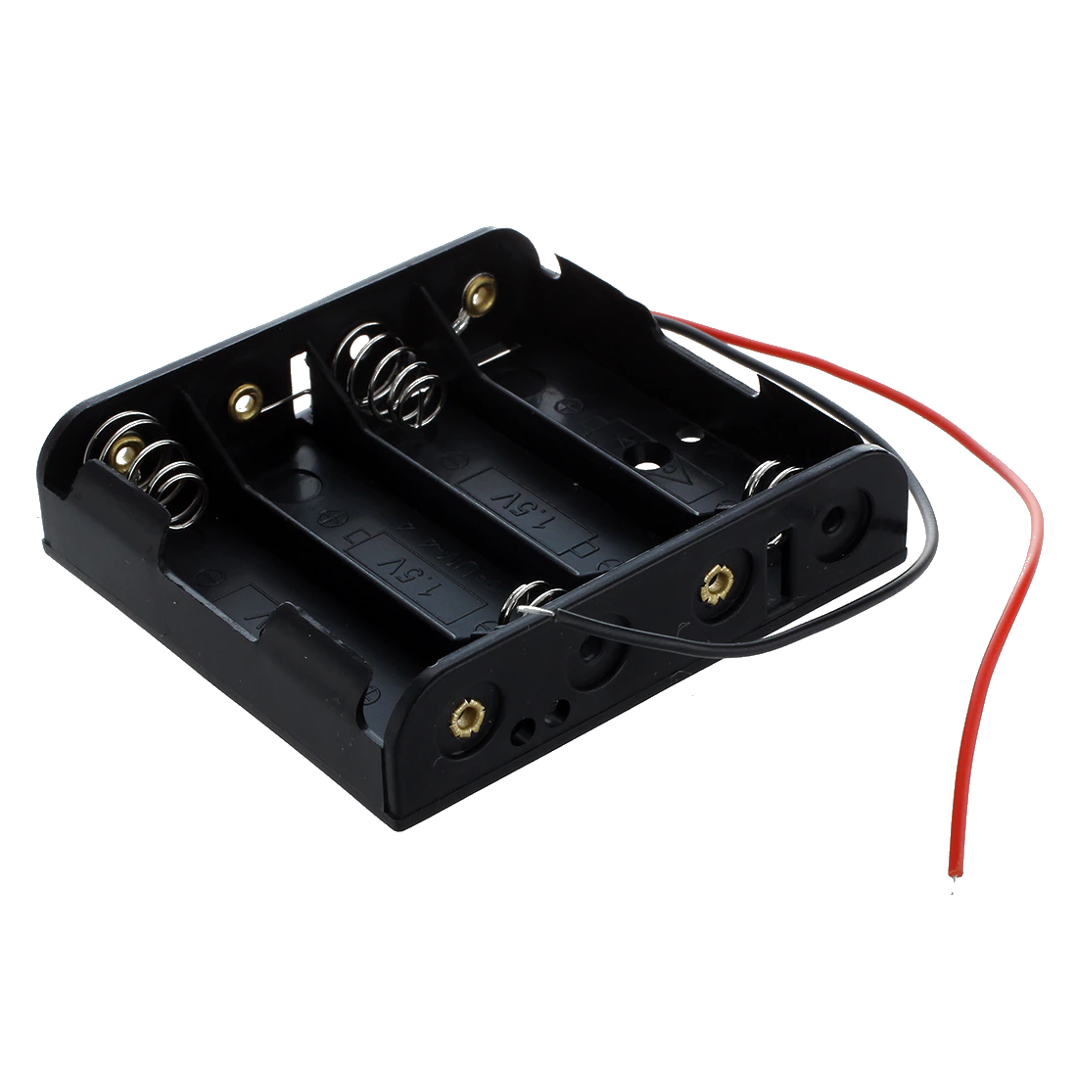
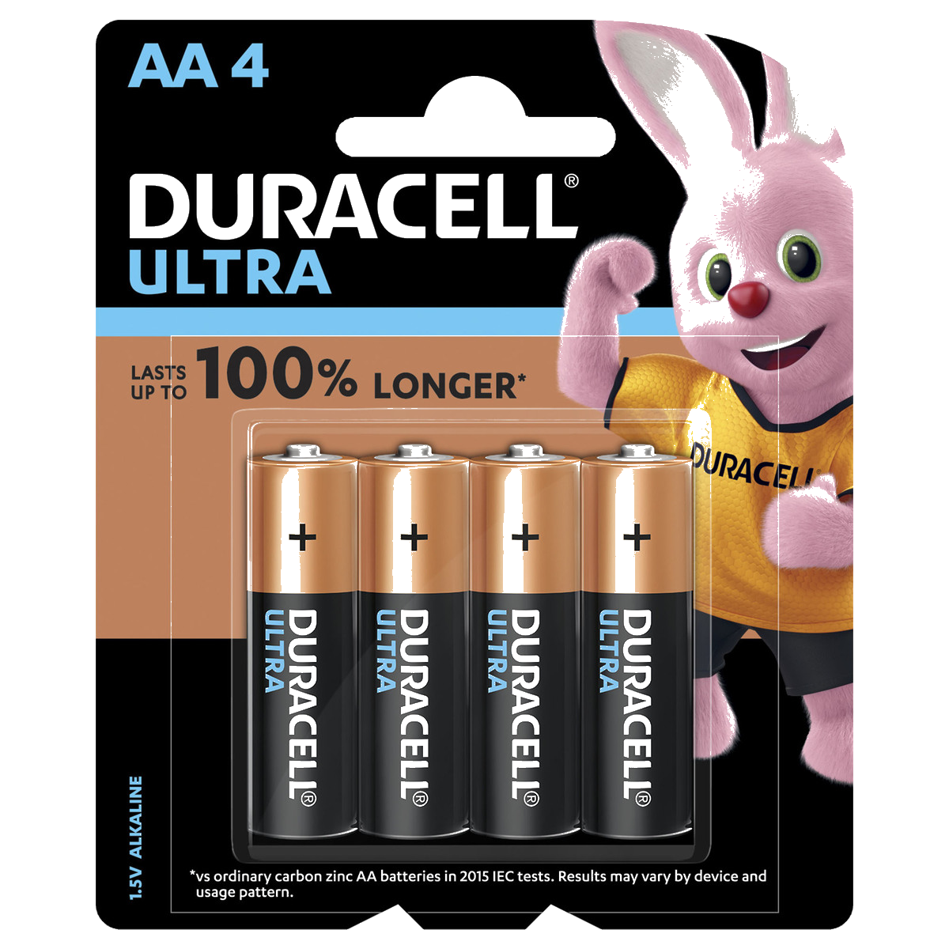
Breadboard
This is used for connecting all the components together.
- Battery holder and 8 AA batteries

Slide 9
Arduino code
// Motor B
int enB = 3;
int in3 = 5;
int in4 = 4;
int state = 0;
void motorAtare()
{ // Turn on motor A
digitalWrite(in1, LOW);
digitalWrite(in2, HIGH);
analogWrite(enA,255);
}
void motorAtareinvers()
{ // Turn on motor A
digitalWrite(in1, HIGH);
digitalWrite(in2, LOW);
analogWrite(enA,255);
}
int enA = 9;
int in1 = 8;
int in2 = 7;
int buzzer = 12;
int firesensor = 10;
int i;
int fire_detected=0;
int fire_analog=0;
int red_led=11;
int blue_led=13;
const long interval = 1000;
int blue_ledState = LOW;
int red_ledState = LOW;
void motorBtare()
{ // Turn on motor B
digitalWrite(in3, LOW);
digitalWrite(in4, HIGH);
analogWrite(enB,255);
}
void motorBtareinvers()
{ // Turn on motor B
digitalWrite(in3, HIGH);
digitalWrite(in4, LOW);
analogWrite(enB,255);
}

Slide 10
void masinastangatare()
{
digitalWrite(in1, LOW);
digitalWrite(in2, HIGH);
digitalWrite(in3, HIGH);
digitalWrite(in4, LOW);
analogWrite(enA,255);
analogWrite(enB,255);
}
void masinadreaptatare()
{
digitalWrite(in1, HIGH);
digitalWrite(in2, LOW);
digitalWrite(in3, LOW);
digitalWrite(in4, HIGH);
analogWrite(enA,255);
analogWrite(enB,255);
}
void motorAincet()
{ // Turn on motor A
digitalWrite(in1, LOW);
digitalWrite(in2, HIGH);
for(i=1;i<200;i++)
analogWrite(enA,i);
}
void motorBincet()
{ // Turn on motor B
digitalWrite(in3, LOW);
digitalWrite(in4, HIGH);
for(i=1;i<200;i++)
analogWrite(enB,i);
}
void motorAinapoi()
{ // Turn on motor A
digitalWrite(in1, HIGH);
digitalWrite(in2, LOW);
analogWrite(enA,10);
}
void motorBinapoi()
{ // Turn on motor B
digitalWrite(in3, HIGH);
digitalWrite(in4, LOW);
analogWrite(enB,10);
}

Slide 11
void masinaINAINTEviteza()
{ // Turn on motor A
digitalWrite(in1, LOW);
digitalWrite(in2, HIGH);
digitalWrite(in3, LOW);
digitalWrite(in4, HIGH);
analogWrite(enA,255);
analogWrite(enB,255);
}
void masinaINAINTEincet()
{
digitalWrite(in1, LOW);
digitalWrite(in2, HIGH);
digitalWrite(in3, LOW);
digitalWrite(in4, HIGH);
for(i=1;i<200;i++)
{analogWrite(enA,i);
analogWrite(enB,i);
}
}
void masinaINAPOI()
{
digitalWrite(in1, HIGH);
digitalWrite(in2, LOW);
digitalWrite(in3, HIGH);
digitalWrite(in4, LOW);
for(i=1;i<250;i++)
{analogWrite(enA,i);
analogWrite(enB,i);
}
}
void masinaFRANA()
{
digitalWrite(in1, LOW);
digitalWrite(in2, LOW);
digitalWrite(in3, LOW);
digitalWrite(in4, LOW);
}
void motorAstop()
{
digitalWrite(in1, LOW);
digitalWrite(in2, LOW);
}
void motorBstop()
{
digitalWrite(in3, LOW);
digitalWrite(in4, LOW);
}

Slide 12
fire_detected = digitalRead(firesensor);
fire_analog=analogRead(A0);
Serial.print("A0 value is: ");
Serial.println(fire_analog);
if (fire_detected == 1)
{
digitalWrite(buzzer, HIGH);
// if the LED is off turn it on and vice-versa:
if (blue_ledState == LOW) {
blue_ledState = HIGH;
} else {
blue_ledState = LOW;
}
// set the LED with the ledState of the variable:
digitalWrite(blue_led, blue_ledState);
digitalWrite(red_led, !(blue_ledState));
}
//Serial.println("fire detected");
}
else
{
digitalWrite(buzzer, LOW);
digitalWrite(blue_led, LOW);
digitalWrite(red_led, LOW);
//Serial.println("fire not detected");
}
Serial.println(fire_detected);
if(Serial.available() > 0){
char state = Serial.read();
void setup() {
pinMode(enA, OUTPUT);
pinMode(enB, OUTPUT);
pinMode(in1, OUTPUT);
pinMode(in2, OUTPUT);
pinMode(in3, OUTPUT);
pinMode(in4, OUTPUT);
pinMode(buzzer, OUTPUT);
pinMode(red_led, OUTPUT);
pinMode(blue_led, OUTPUT);
pinMode(firesensor, INPUT);
//digitalWrite(pump, HIGH);
Serial.begin(9600); // Default connection rate for my BT module
}

Slide 13
switch(state)
{
case 'A' :{Serial.println("masina inainte viteza");masinaINAINTEviteza();break;}
case 'B' :{Serial.println("masina inainte incet");masinaINAINTEincet();break;}
case 'C' :{Serial.println("masina frana");masinaFRANA();break;}
case 'D' :{Serial.println("masina inapoi");masinaINAPOI();break;}
case 'E' :{Serial.println("stanga tare");masinastangatare();break;}
case 'F' :{Serial.println("dreapta tare");masinadreaptatare();break;}
case 'G' :{Serial.println("stanga incet");motorAincet();break;}
case 'H' :{Serial.println("dreapta incet");motorBincet();break;}
//case 'K' :{Serial.println("pompa pornita");pompaStop();break;}
//case 'L' :{Serial.println("pompa oprita");pompaStart();break;}
default : break;
}
}
delay(50);
}

Slide 14
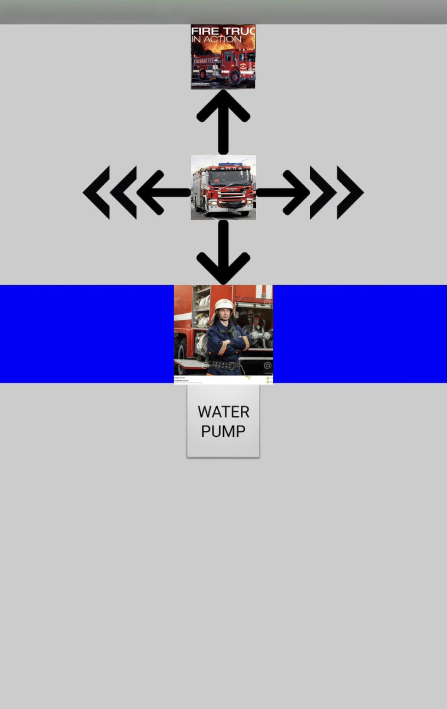
Bluetooth Control
The fire truck is controlled using an Android application created with MIT App Inventor. In this scope we also added an bluetooth module.
The interface looks like this:

Slide 15
Further developments
- Making the water pump work;
Project demonstration

Slide 16

Thank you for your attention!

